Slide 1
Greenplum Workshop
Apache MADlib™

Slide 2
Agenda
Why MADlib® ?
What is MADlib®
Current MADlib® routines
Small examples

Slide 3
Why MADlib® ?
Most analytics is done by pulling the data to the analytic engine
Some engines only accommodate in memory data
Sample data is the fall back – often not satisfactory
Time to pull often outweighs analytic processing time
Developers sometimes write their own code
There is a better way

Slide 4




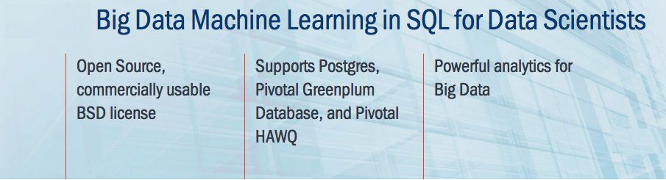
Scalable, In-Database Machine Learning
Open Source Apache Top Level Progress
Works on Greenplum and PostgreSQL
In active development by Pivotal
Downloads and Docs: http://madlib.apache.org/
Notes:
What is MADlib?
MADlib is an open source machine learning library built and maintained by Pivotal.
Runs in-database on GPDB, HAWQ and PostgreSQL. Many machine learning tools require you to move the data from a data souce into an analytic workstation. This costs in transport time to move the data and often limits the size of the data set to what can fit in memory in the analytic workstation.
Main goal of MADlib is machine learning on large data sets. This means a focus on:
Scalability
Performance

Slide 5
MADlib Advantages
Better parallelism
Algorithms designed to leverage MPP and Hadoop architecture
Better scalability
Algorithms scale as your data set scales
Better predictive accuracy
Can use all data, not a sample
Open source
Available for customization and optimization by user if desired
Notes:
Parallelism
Implement the algorithms to be distributed across segments and take advantage of the MPP architecture
Hard to do: MADlib team needs to do on algo by algo basis, not a general or automatic way to do it (depending on algo, get varying degrees of parallelism)
Scalability
Add nodes as data set scales
Don’t need to make software changes for different size data sets
No sampling
Do not have to sample the data so better accuracy (potentially)
E.g., high cardinality dimensions where sampling may result in too sparse data per dimensional value
Open source

Slide 6
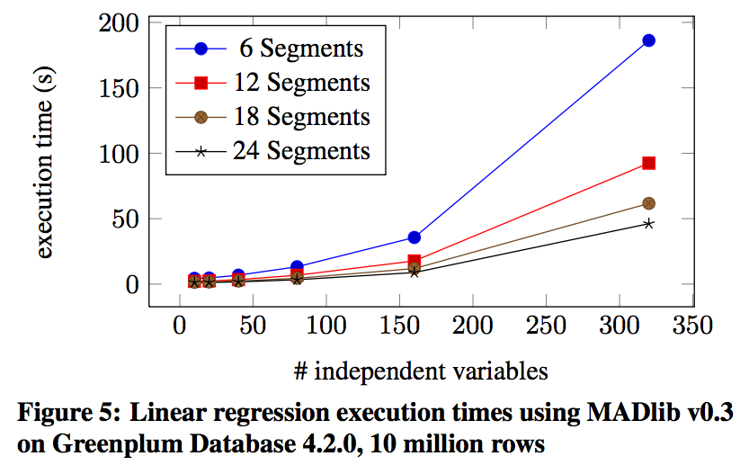
Performing a linear regression on 10 million rows in seconds
Hellerstein, Joseph M., et al. "The MADlib analytics library: or MAD skills, the SQL." Proceedings of the VLDB Endowment 5.12 (2012): 1700-1711.
Notes:
For a table of 10 million rows
Num of independent variables (x axis) = number of columns in table.
So a vertical slice allows you to look at scalability.
See roughly linear scale in execution time with number of segments.
* e.g., 6 segments approx 200 sec, 24 segments approx 50 sec (4x faster)

Slide 7

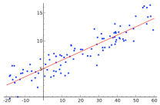
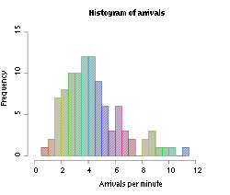
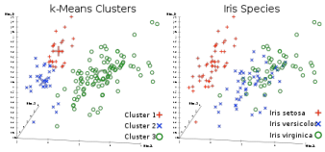
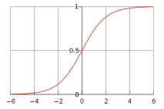
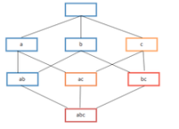
™ Functions
Predictive Analytics Library
Supervised Learning
Regression Models
Cox Proportional Hazards Regression
Elastic Net Regularization
Generalized Linear Models
Linear Regression
Logistic Regression
Marginal Effects
Multinomial Regression
Ordinal Regression
Robust Variance, Clustered Variance
Support Vector Machines
Tree Methods
Decision Tree
Random Forest
Other Methods
Conditional Random Field
Naïve Bayes
Unsupervised Learning
Association Rules (Apriori)
Clustering (K-means)
Topic Modeling (LDA)
Data Types and Transformations
Array Operations
Dimensionality Reduction (PCA)
Encoding Categorical Variables
Matrix Operations
Matrix Factorization (SVD, Low Rank)
Norms and Distance Functions
Sparse Vectors
Time Series
ARIMA
Model Evaluation
Cross Validation
Statistics
Descriptive
Cardinality Estimators
Correlation
Summary
Inferential
Hypothesis Tests
Other Statistics
Probability Functions
Other Modules
Conjugate Gradient
Linear Solvers
PMML Export
Random Sampling
Term Frequency for Text
Aug 2015
Notes:
List of MADlib functions is growing every day.

Slide 8


Architecture
User Interface
SQL
High-level Abstraction Layer
(iteration controller, ...)
Python
RDBMS
Built-in Functions
Functions for Inner Loops
(implements convex optimization)
C++
Low-level Abstraction Layer
(matrix operations,
C++ to DB type bridge, …)
RDBMS Query Processing
(Greenplum, HAWQ, PostgreSQL)

Slide 9


Pivotal Technology: Hadoop & HAWQ
Performance through massive parallelism
Automatic parallelization
Load and query like any database
Automatically distributed tables across nodes
Analytics-oriented query optimization
Scalable MPP architecture
All nodes can scan and process in parallel
Linear scalability by adding nodes

Slide 10
Calling MADlib Functions: Fast Training, Scoring
Table containing training data
MADlib model function
MADlib allows users to easily and create models without moving data out of the systems
Model generation
Model validation
Scoring (evaluation of) new data
All the data can be used in one model
Built-in functionality to create of multiple smaller models (e.g. classification grouped by feature)
Open-source lets you tweak and extend methods, or build your own
Table in which to save results
SELECT madlib.linregr_train( 'houses’,
'houses_linregr’,
'price’,
'ARRAY[1, tax, bath, size]’);
Column containing dependent variable
Features included in the model
Notes:
Let’s take a look at linear regression, a common and useful predictive tool.
The first thing to notice is that you don’t write any code to do this, just read the documentation to learn the calling sequence and arrange the data.
In doing this kind of analysis, we first train the model on a sample of the data and then test the model by applying it to the rest of the data in what is called scoring the data.
In linear regression , the variable we’re trying to predict is called the dependent variable and the variables we use to predict it are the independent variable. They must be float8 data types. If they’re not, you can cast them to float8.

Slide 11
Calling MADlib Functions: Fast Training, Scoring
Table containing training data
MADlib model function
MADlib allows users to easily and create models without moving data out of the systems
Model generation
Model validation
Scoring (evaluation of) new data
All the data can be used in one model
Built-in functionality to create of multiple smaller models (e.g. classification grouped by feature)
Open-source lets you tweak and extend methods, or build your own
Table in which to save results
SELECT madlib.linregr_train( 'houses’,
'houses_linregr’,
'price’,
'ARRAY[1, tax, bath, size]’,
‘style’);
Column containing dependent variable
Features included in the model
Create multiple output models (one for each value of house style)
Notes:
What happens if you have a categorical variable like color , that’s non numeric. You can create different models for each category. Here we will create a different model dependng on the style of the house.

Slide 12
Calling MADlib Functions: Fast Training, Scoring
MADlib allows users to easily and create models without moving data out of the systems
Model generation
Model validation
Scoring (evaluation of) new data
All the data can be used in one model
Built-in functionality to create of multiple smaller models (e.g. classification grouped by feature)
Open-source lets you tweak and extend methods, or build your own
SELECT madlib.linregr_train( 'houses’,
'houses_linregr’,
'price’,
'ARRAY[1, tax, bath, size]’);
MADlib model scoring function
SELECT houses.*, madlib.linregr_predict(ARRAY[1,tax,bath,size], m.coef
)as predict
FROM houses, houses_linregr m;
Table with data to be scored
Table containing model
Notes:
Once you have generated the model, you then can test your model by scoring the remaining data. Once you have validated the model, when new data arrives, you can score or predict the house price predicated upon the independent variables.

Slide 13
Pointer to Documentation
General madlib documentation
http://madlib.apache.org/documentation.html
Quick Start Guide
https://cwiki.apache.org/confluence/display/MADLIB/Quick+Start+Guide+for+Users

Slide 14

Transforming How The World Builds Software
© Copyright 2018 Pivotal Software, Inc. All rights Reserved.

